Slide 1

PokéQuest: A Comprehensive Dive into Pokémon Data
Group 7 :
Lakshmi Neharika Anchula
Athira Thekkemadathil Anilkumar
Swati Das
INFO 523 FA23 001

Slide 2
Our Dataset:
"Pokemon Dataset" from Kaggle
The dataset comprises a single .csv file listing the 890 known Pokémon up to the 8th Generation, along with their respective variations.
Our Data: pokemon_data

Slide 3
Our Dataset:
This project aims to categorize and explore the unique traits and attributes associated with various types of Pokémon within the Pokémon universe.
Why do we choose Pokemon Dataset? :
Childhood memories of Pokémon often evoke a sense of wonder, excitement, and imagination as Pokémon encompass a wide array of species, each with unique abilities, types, and characteristics. This diversity allows for comprehensive exploration of various traits and attributes.

Slide 4
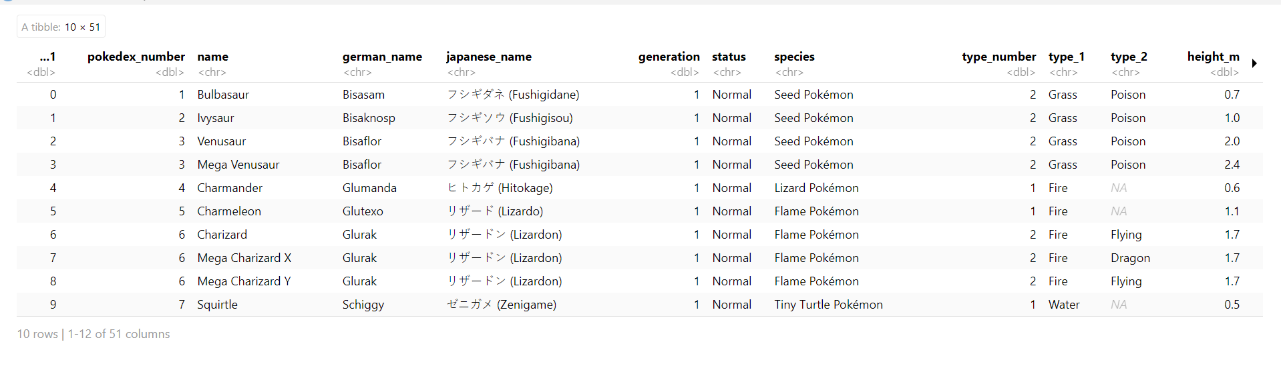
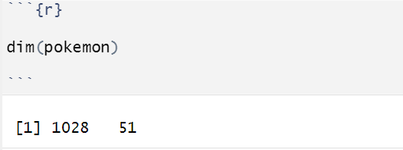
The data is sourced from Kaggle and has roughly 890 Pokemon.
Our dataset contains 1028 rows and 51 columns.

Slide 5
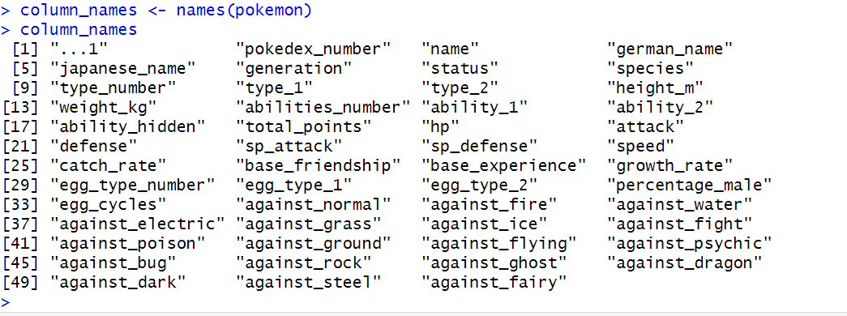
The dataset contains following columns:

Slide 6
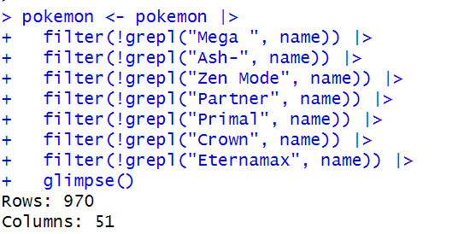
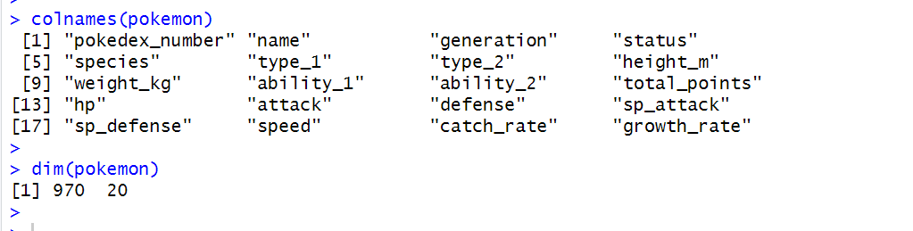
Data Preprocessing:
Removed the Mega Transformation Pokemon from the dataset.
Removed the columns which is not required.

Slide 7
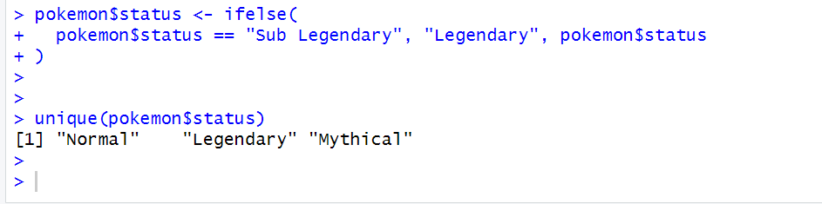
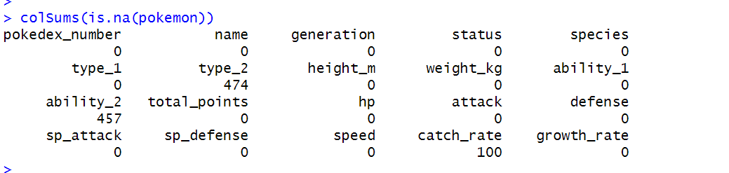
Merging Sub-legendary Pokemon to Legendary Pokemon
Checking the columns which are having NA values
Filling the missing values of "catch_rate" with mean
Leaving the missing values of "type_2" and "ability_2" as it is not necessary for the pokemon to have secondary type and ability

Slide 8
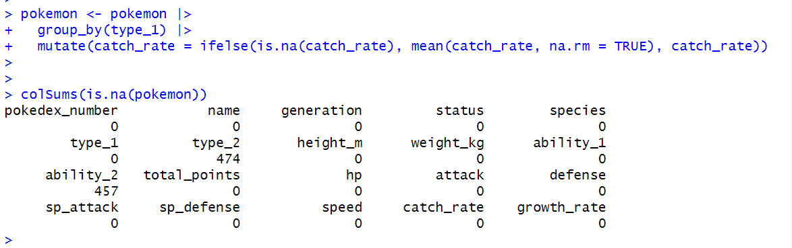

Slide 9
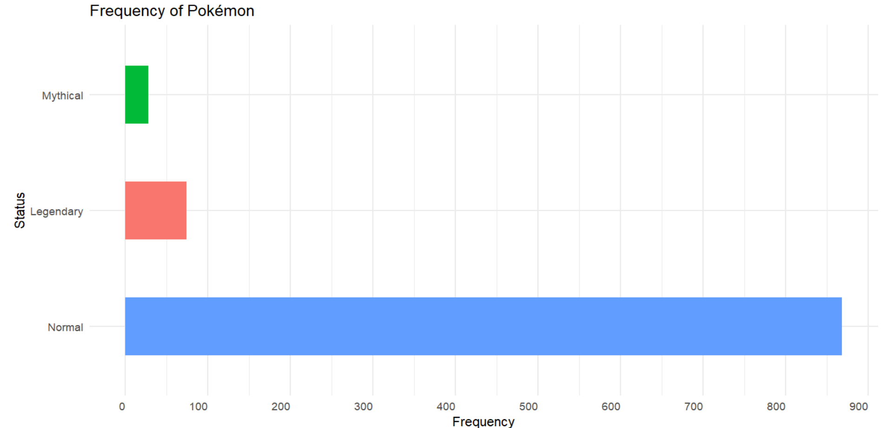
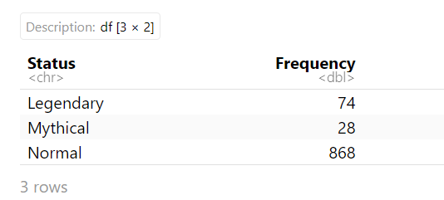
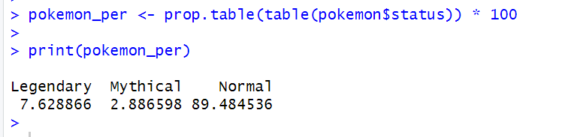
Data Exploration :
Frequency and percentage for different status

Slide 10
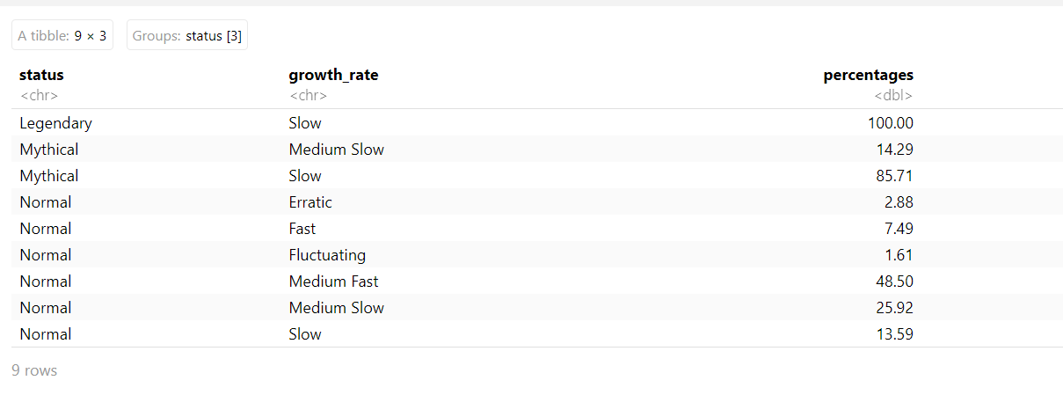
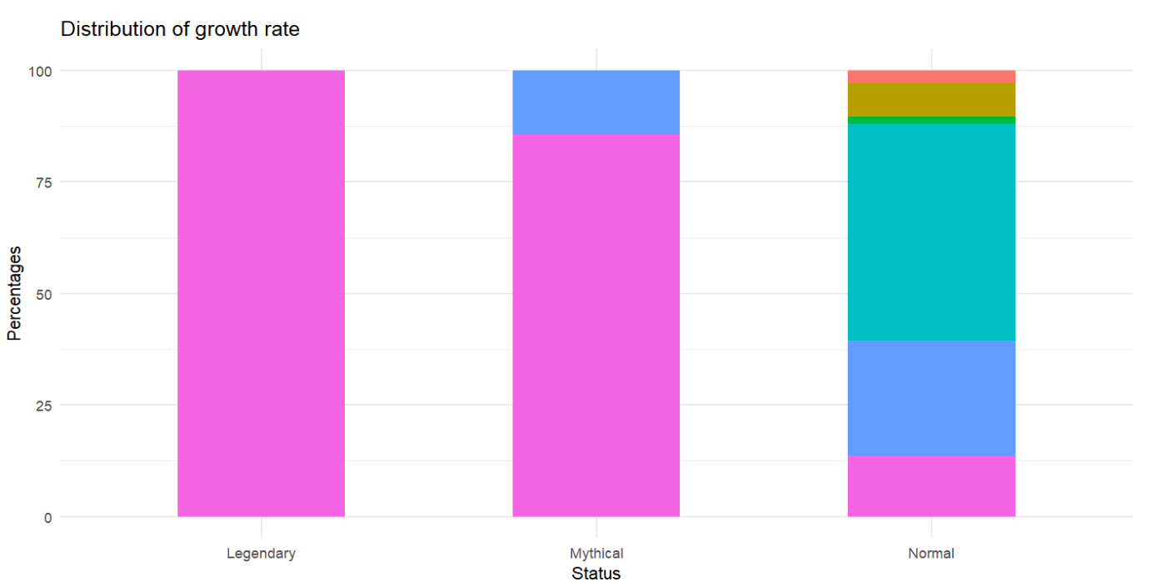
Calculated the percentage distribution of different growth rates within each status category for Pokémon.

Slide 11
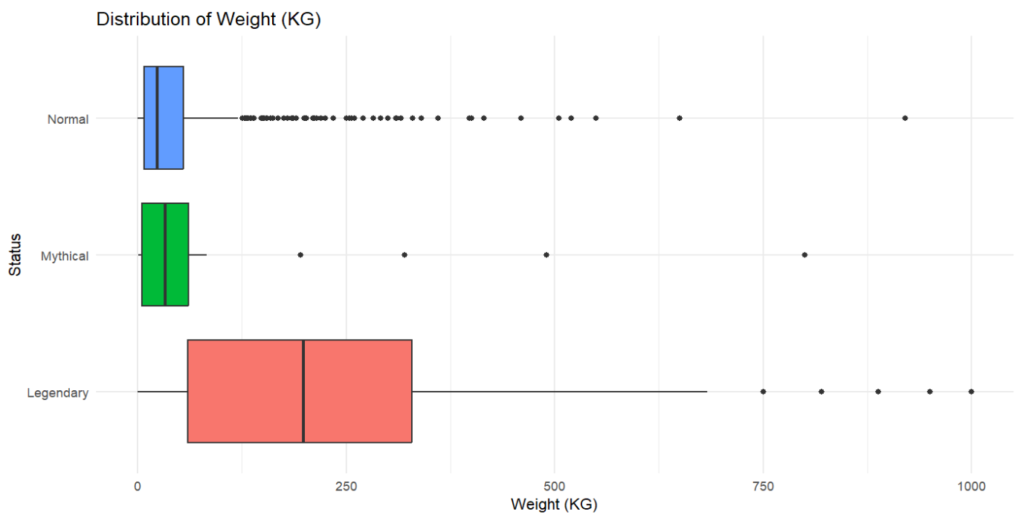
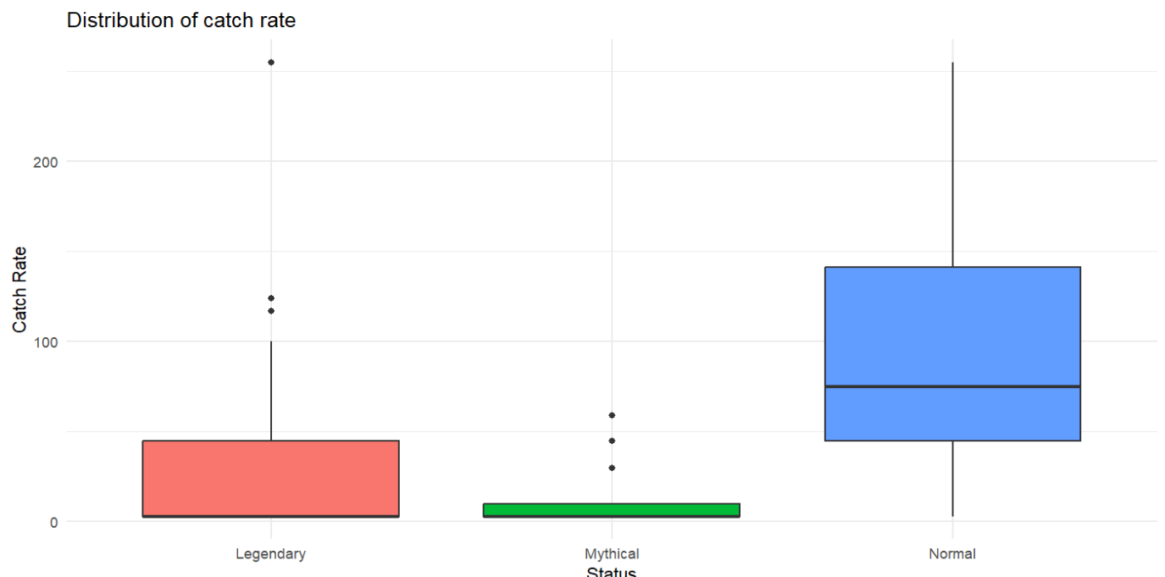
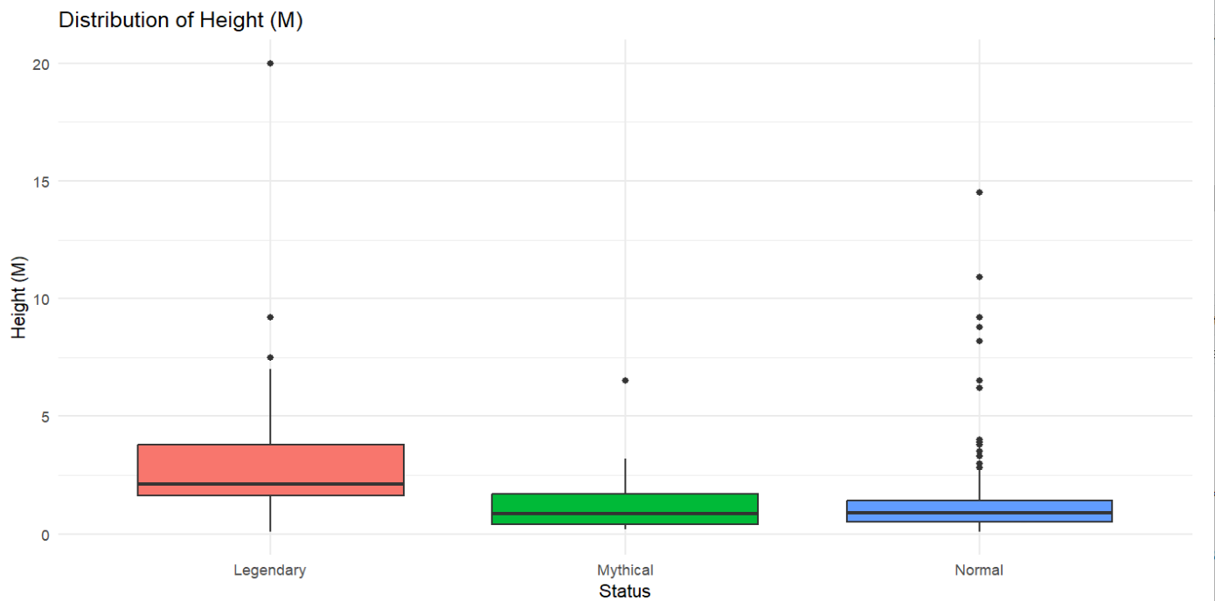
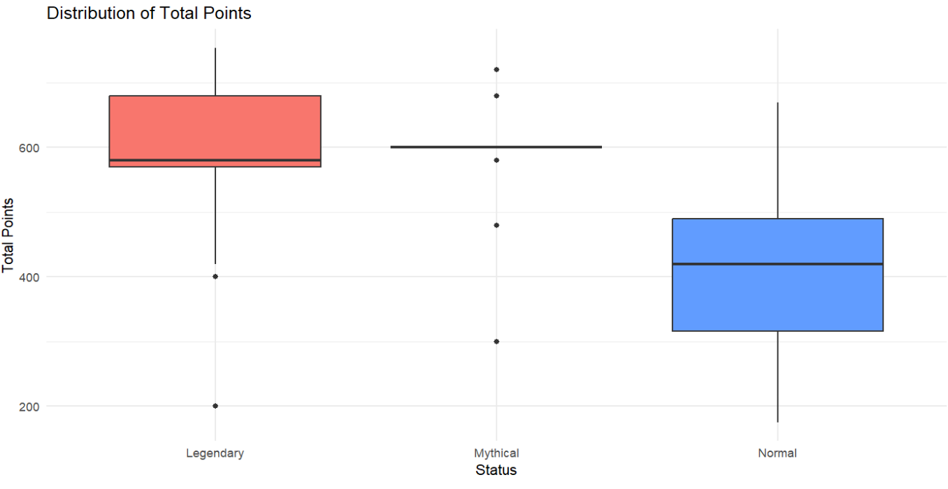
Weight Distribution
Height Distribution
Catch Rate Distribution
Total Points

Slide 12
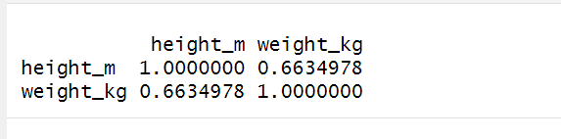
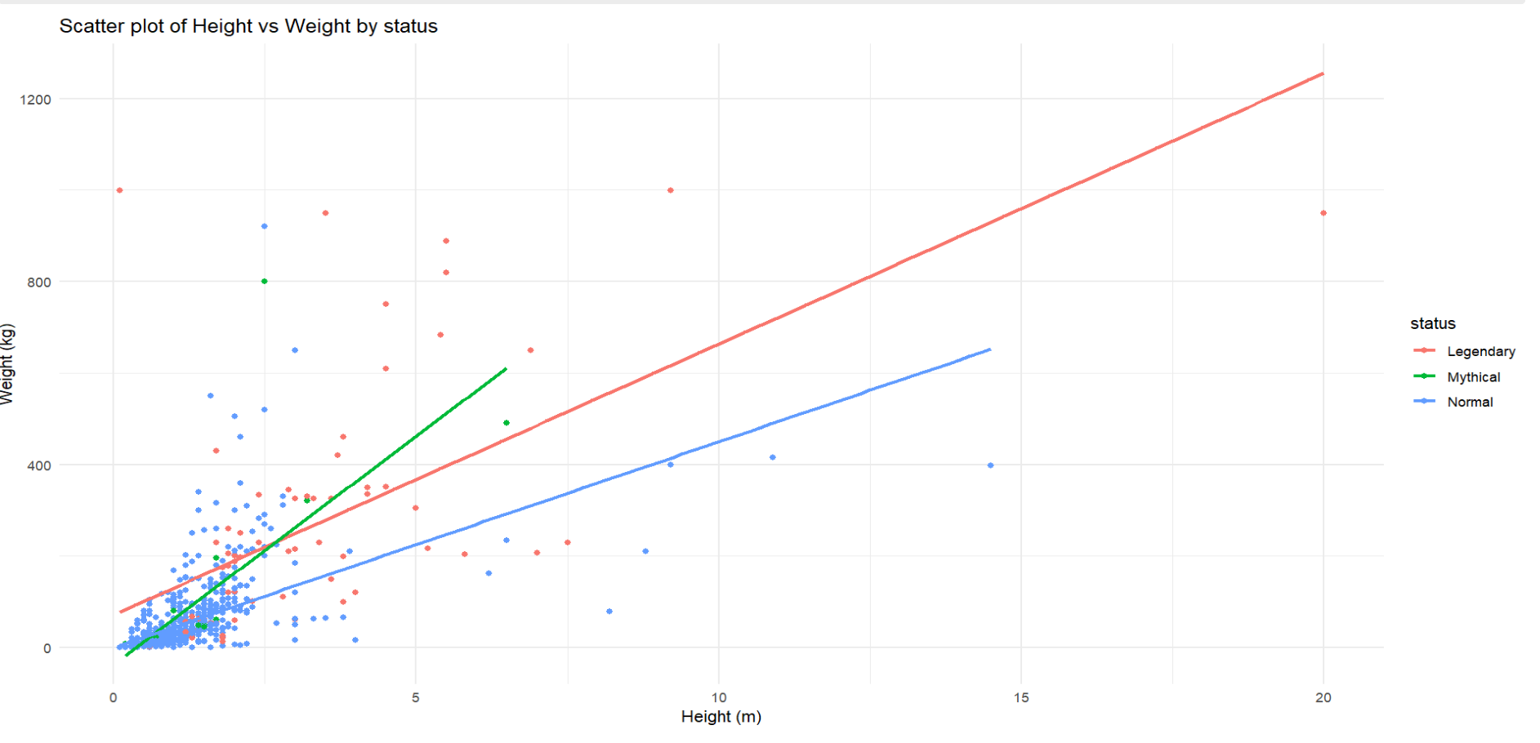
Correlation between Height and Weight

Slide 13
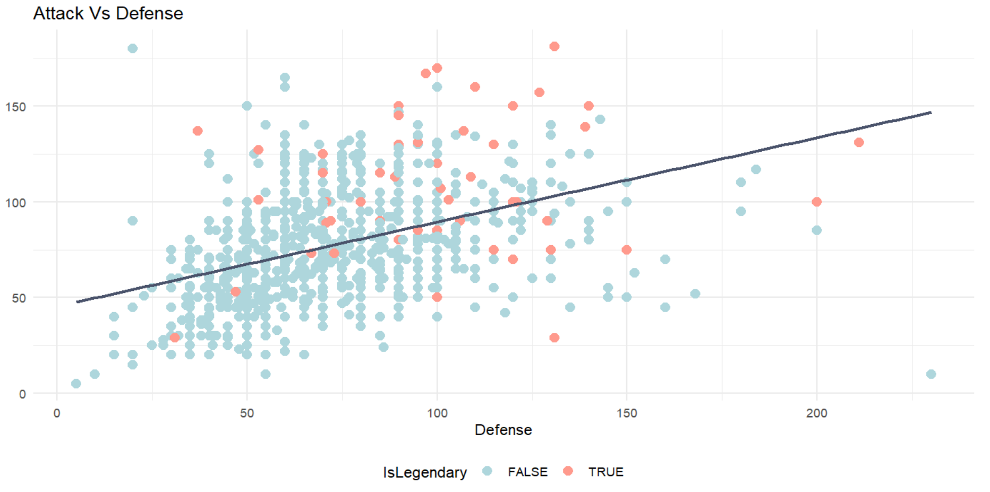
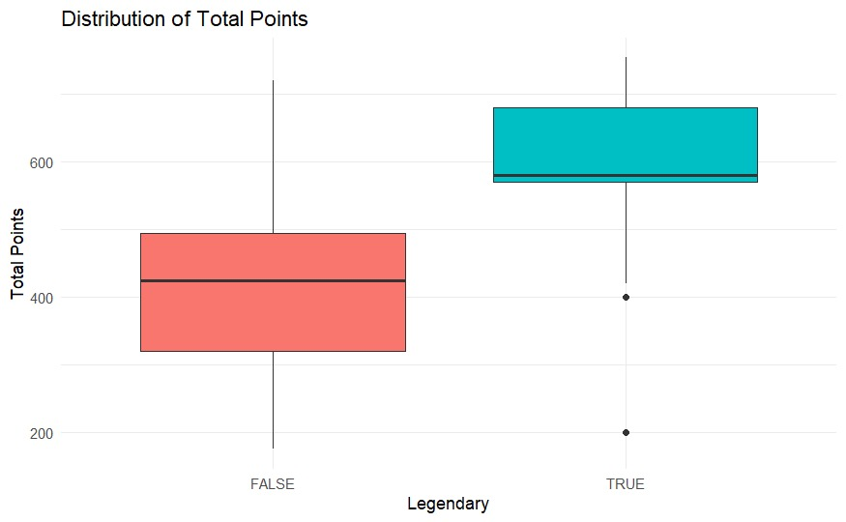
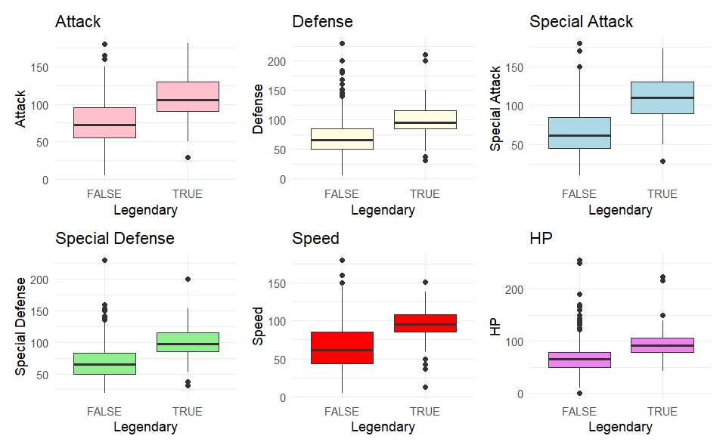
Comparision of skills for legendary and non-legendary Pokemon

Slide 14
Association Rule:
Selection of Relevant Columns:
* Total_Points, CatchRate, Weight, Height, ability_1
Discretization of Continuous Variables:
* Total Points Binning: total_points column is divided into three bins (Low, Medium, High) .
* Catch Rate Binning: catch_rate column is categorized into three bins (Low, Medium, High) based on specified break points (0, 50, 100, 255).
* Weight and Height Binning: weight_kg and height_m columns are divided into three bins each based on quartiles.

Slide 15
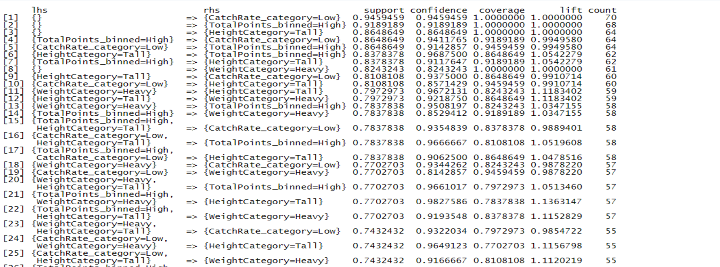
Apriori Algorithm

Slide 16
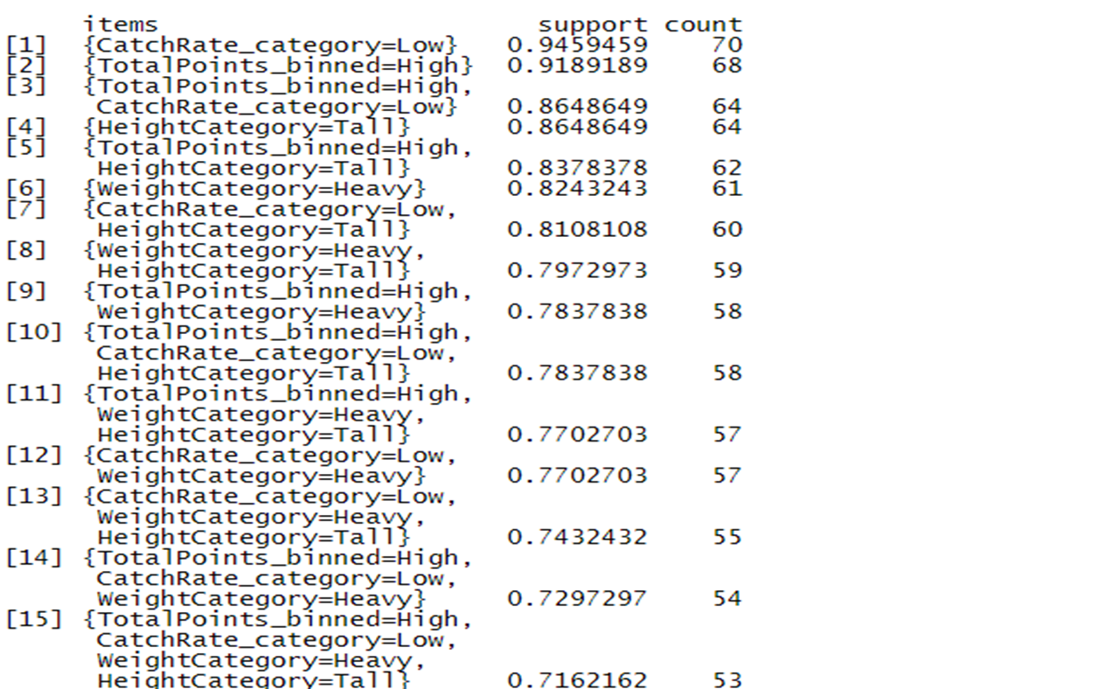
Eclat Algorihm -

Slide 17
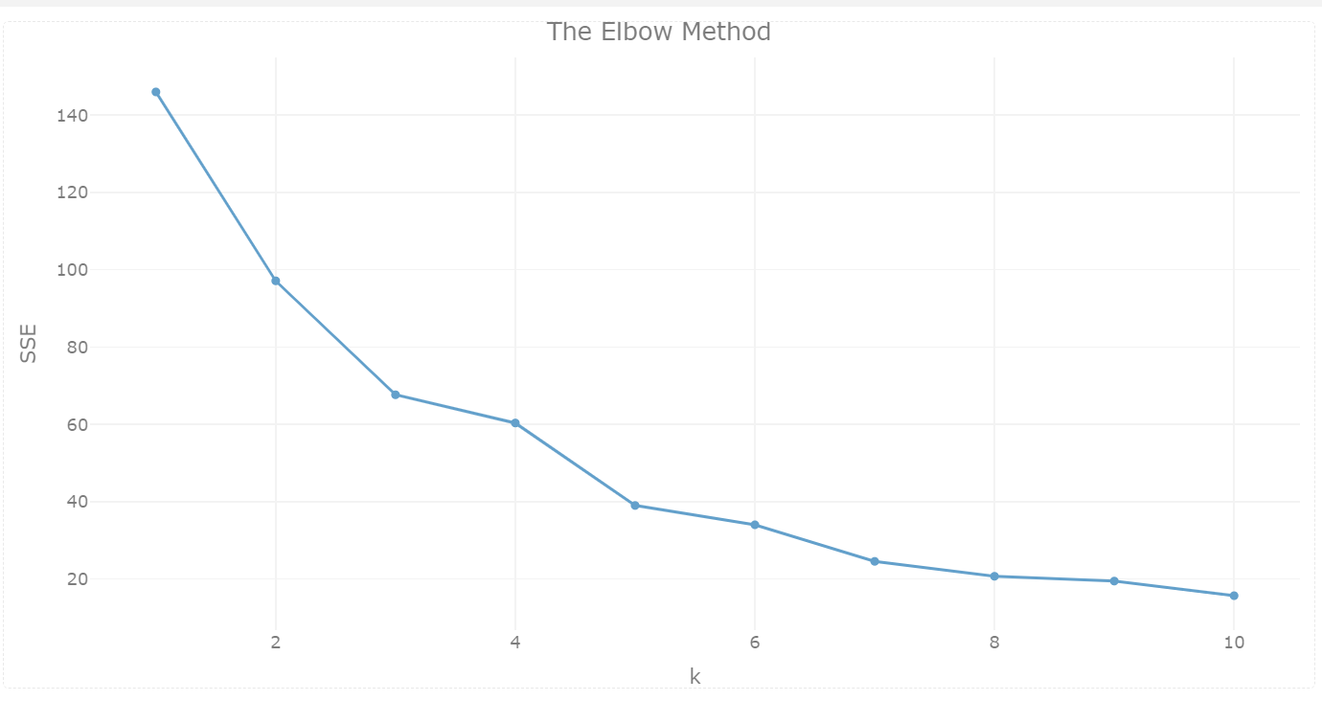
Clustering:
K-Mean -
Clustering the legendary Pokemons by their Attack and Defense stats.
Scaling the Pokemon data and identifying the most suitable cluster count using the Elbow Method.

Slide 18
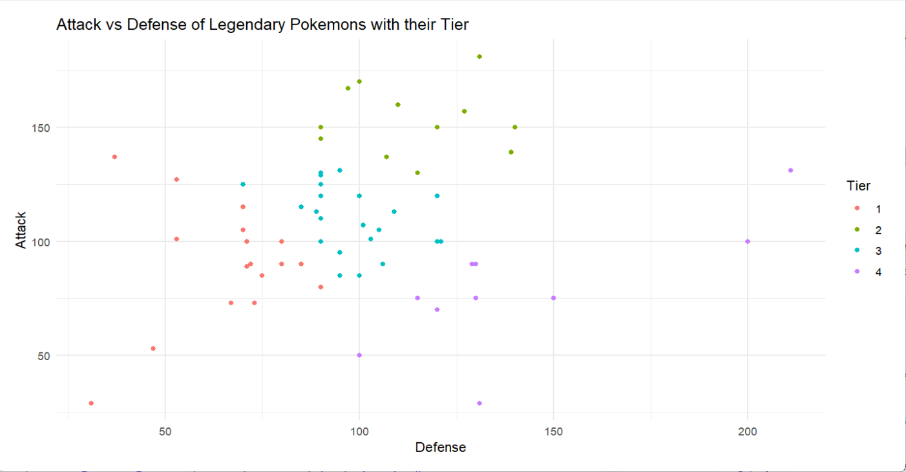
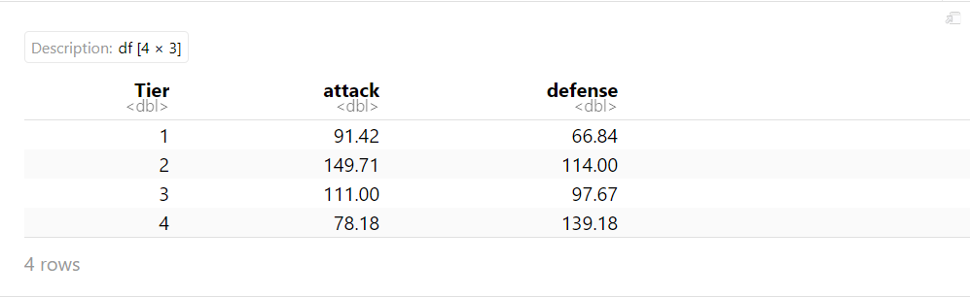
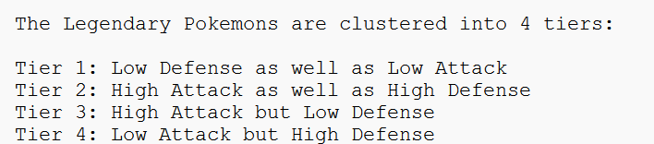
The optimal hyperparameter for our model appears to be k = 4 as the subsequent values of k show a tendency towards a linear trend.
Attack Vs Defense of Legendary Pokemons with their Tier -

Slide 19
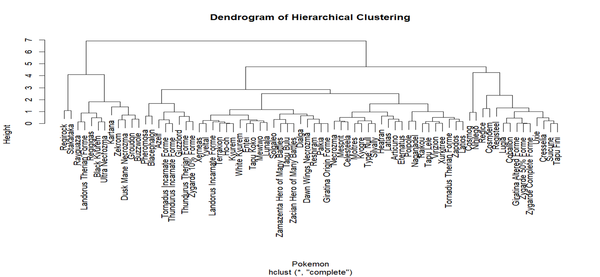
Hierarchical Clustering -
using the complete linkage method

Slide 20
Classification:
Random Forest -
Define target variable and predictor variables.
Employe Random Forest algorithm for classification.
Configured cross-validation with 5 folds for robust model evaluation.
Measure the model accuracy as the performance metric.

Slide 21
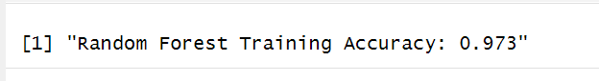
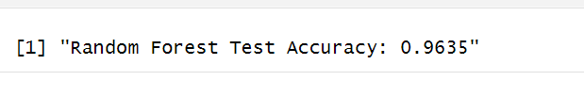
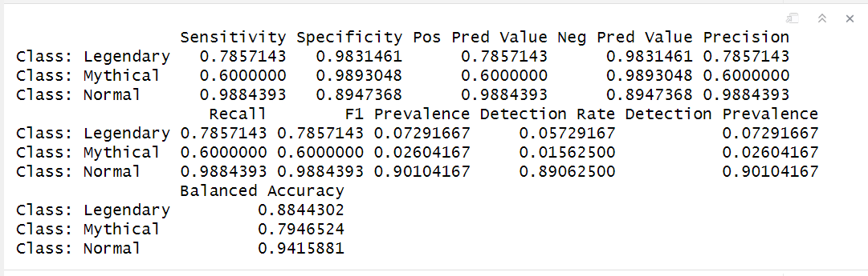
Result Assessment -
Training Accuracy -
Performance Matrix -
Testing Accuracy -

Slide 22
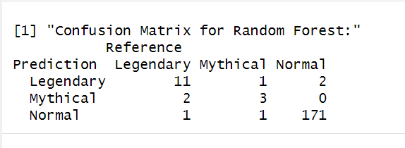
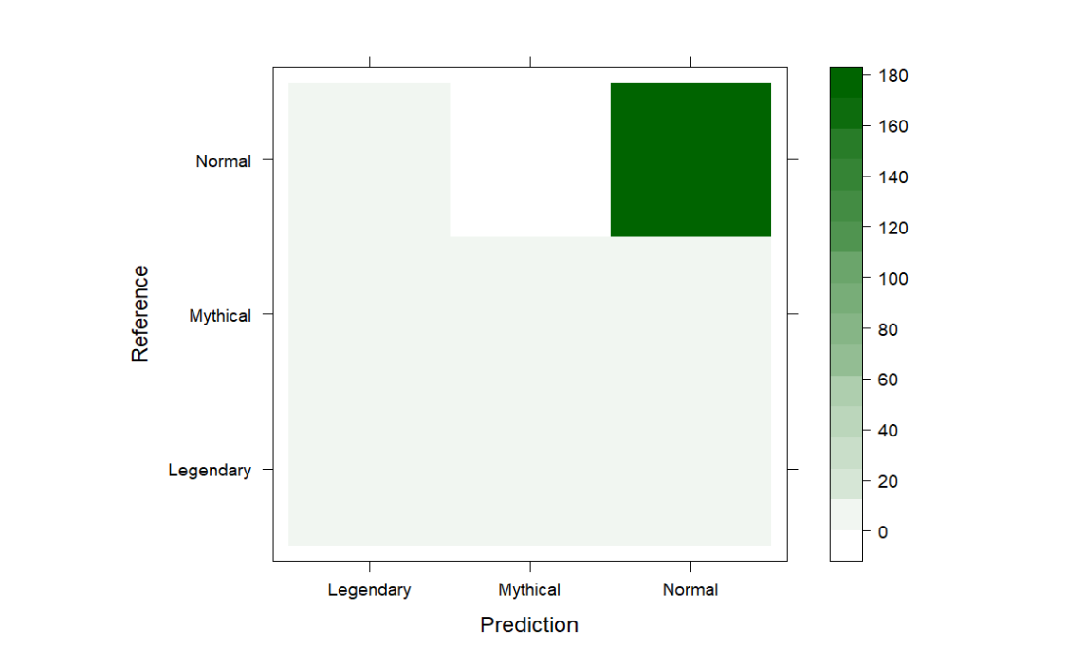
Confusion Matrix

Slide 23
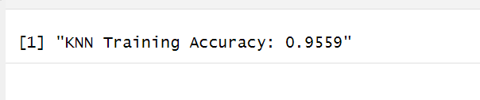
KNN -
Define the predictor variables and target variable.
Apply the KNN algorithm for classification.
Implement 5-fold cross-validation for robust performance estimation.
Chose accuracy as the evaluation metric to assess model performance (metric = "Accuracy").
Result Assessment -
Training Accuracy -

Slide 24
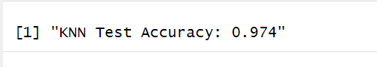
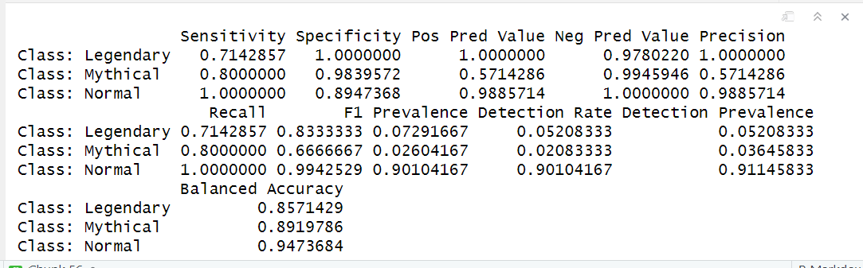
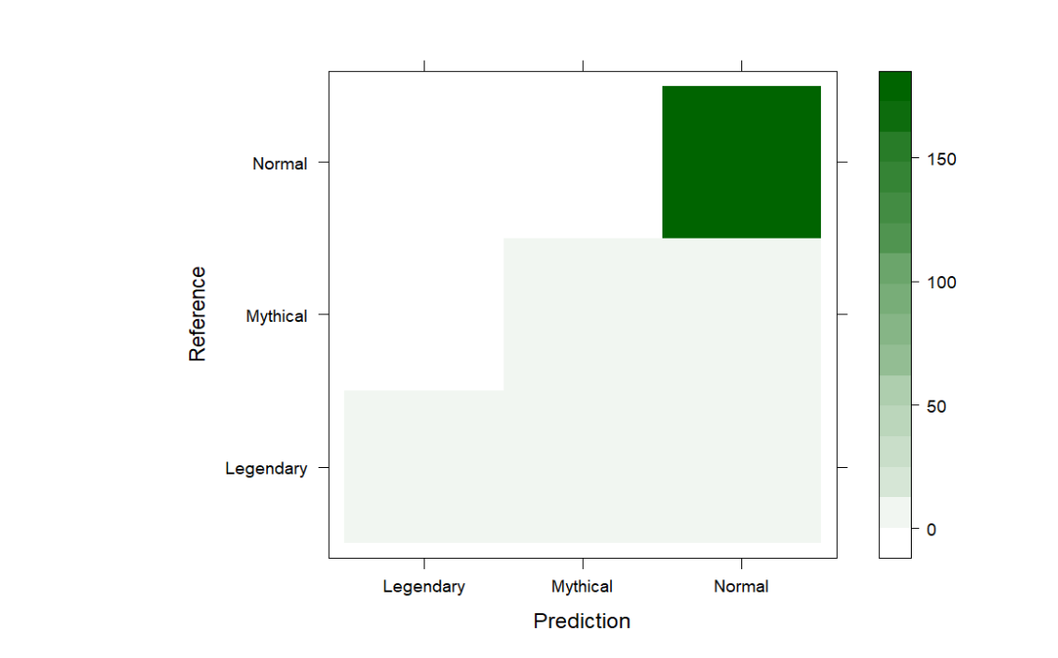
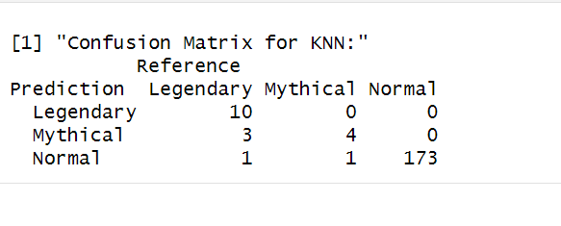
Testing Accuracy -
Confusion Matrix -
Performance Matrix -

Slide 25
Conclusion :
Association rules extracted via Apriori and Eclat algorithms, strong correlations are apparent between different categorical attributes. Particularly, the presence of high total points is frequently associated with attributes like low catch rates, tall height categories, heavy weight categories, and specific primary abilities, showcasing interconnections within the characteristics of Legendary Pokémon.
K-means clustering effectively clustered the dataset into four distinct tiers, displaying clear groupings with mean values indicating discernible differences in attack and defense attributes across tiers.
The hierarchical clustering via complete linkage provided insights into hierarchical relationships among Pokémon based on similarities in attack and defense attributes.
The classification of Pokémon status are done using K-Nearest Neighbors (KNN) and Random Forest algorithms. Assessment of their performance shows that KNN as the superior model, achieving the highest F1 score among the models evaluated.

Slide 26

Thank You

